Slide 1


HOSTEL MANAGEMENT SYSTEM Created By Sayyad Alfiya Dimpal Pansare Guide Name : Prof.Ds Potdar sir

Slide 2
Content
Abstract
Certification
Introduction
Requirements
Features
Objectives
Database Tables
Modules
Types of Users
Project view
Project description

Slide 3



Slide 4
1. Abstract
Hostel Management system is a web application which aims at computerization of current procedure of allocating hostel rooms.
Currently the process involves students filling up the forms and submitting them in respective hostel offices which involves a lot of paperwork, hence less efficient !

Slide 5
“Hostel Management System” is a customized and user-friendly software for Hostel which provide hostel information , hostel room information and hostel student information.
This helps admin to maintain
Hostel facility and establish a connection with student.
Student Record system.
Mainten the complete database of student.

Slide 6
Requirements
We have created the Project using php , Html, CSS, Javascript , jquery and Bootsrap .
The software require to execute the code that is XAMPP Control panel.
For coding we have use sublime text editor 3.
The database created in sql on phpmyadmin.

Slide 7
Features
It has login page for both user as well as admin.
The admin goes through the rooms application applied by the student and allocate them .
The admin views the list of student.
After the completion of duration of time taken by the student the admin is in charger of vacant room.

Slide 8
Objective
The main objective of this project is to reduce the manual work required in the hostel management by using software application.
To build user friendly website to use easily accessible for both student and admin.
This helps to maintaining the proper detail of the hostel student in organized way.
And also reduces the complexity of work and reduces the time required in processing the date.

Slide 9
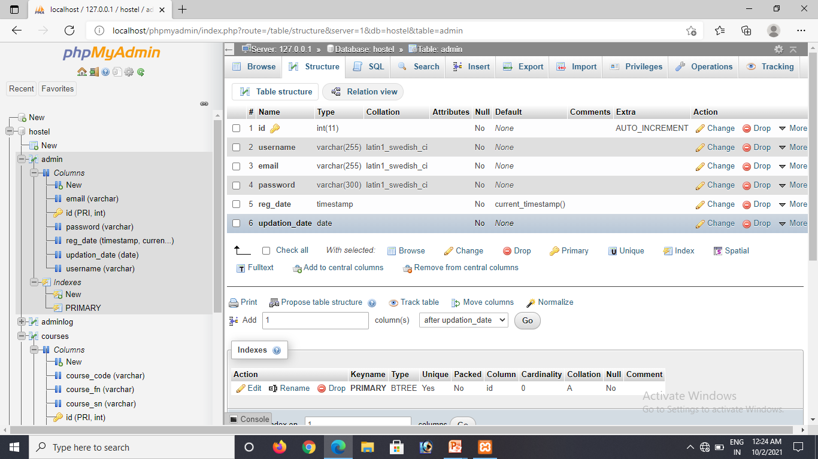
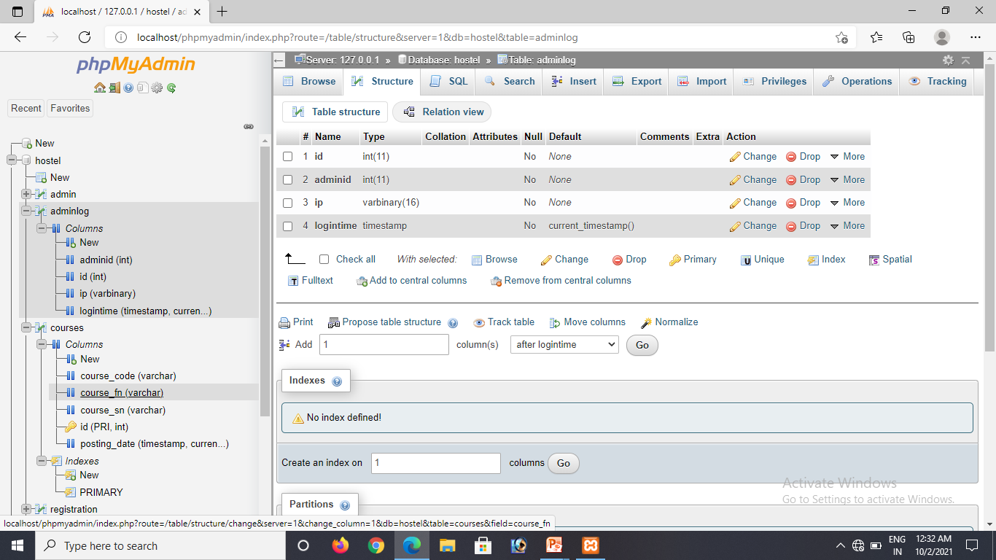
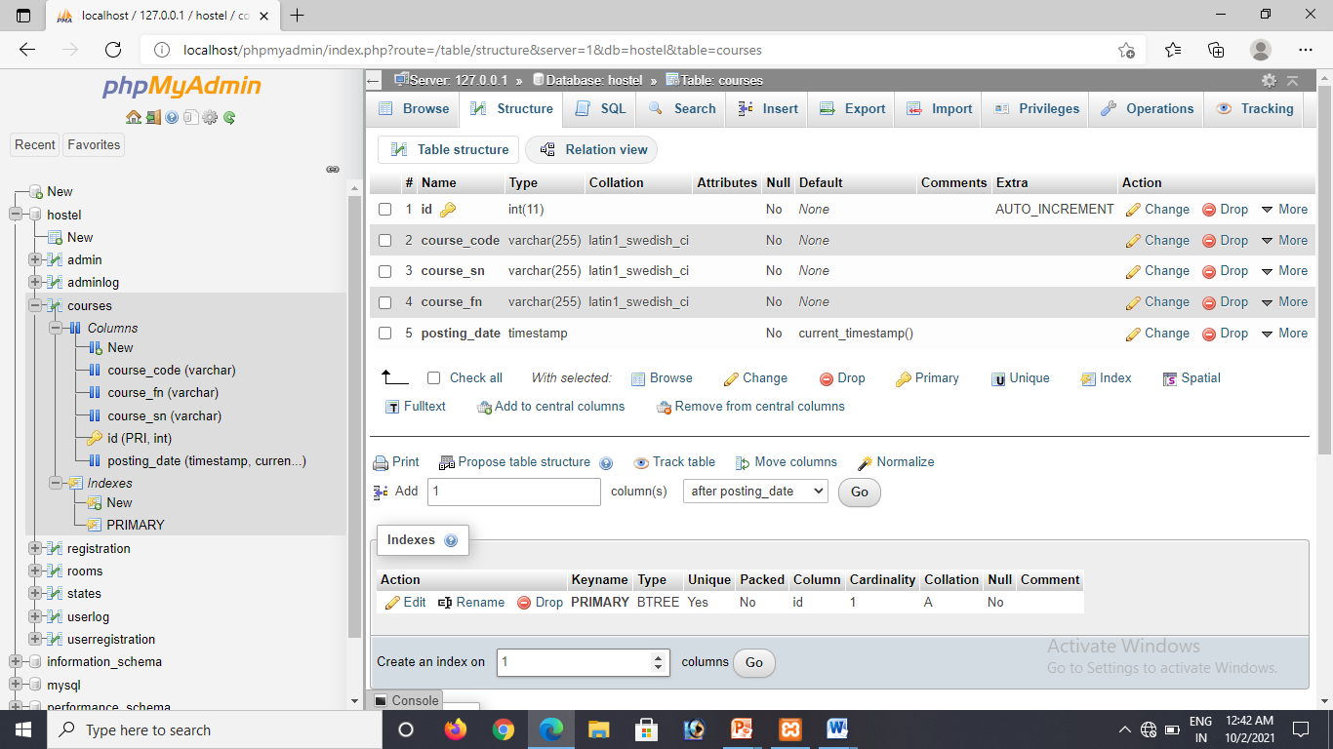
Database Tables

Slide 10
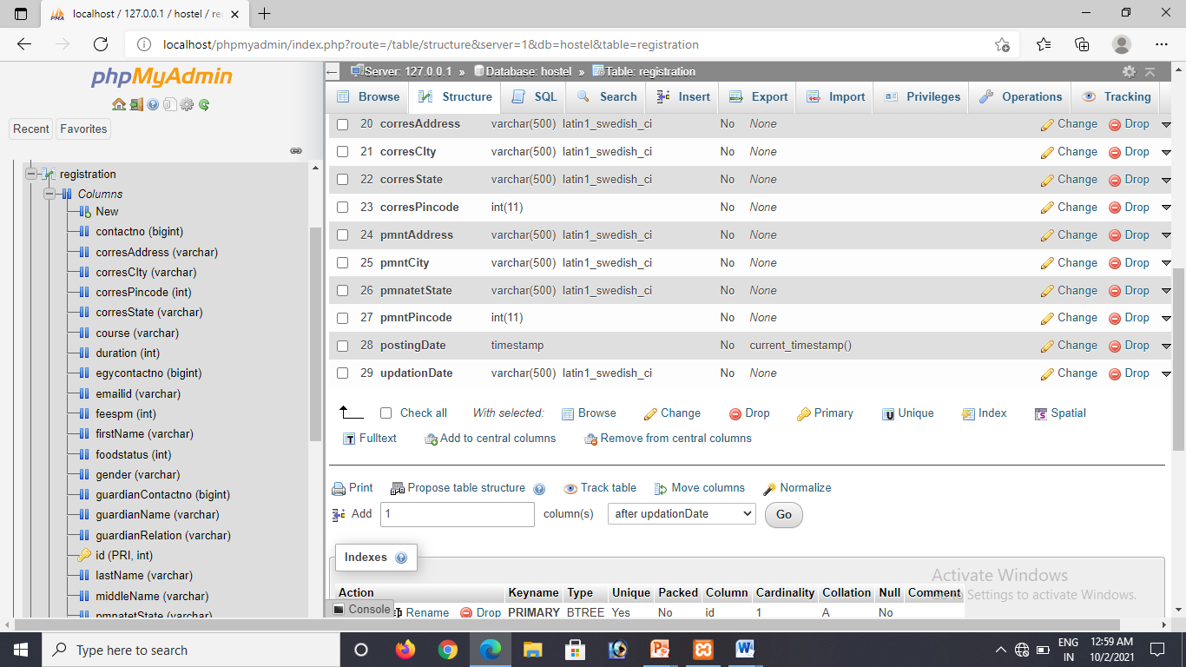
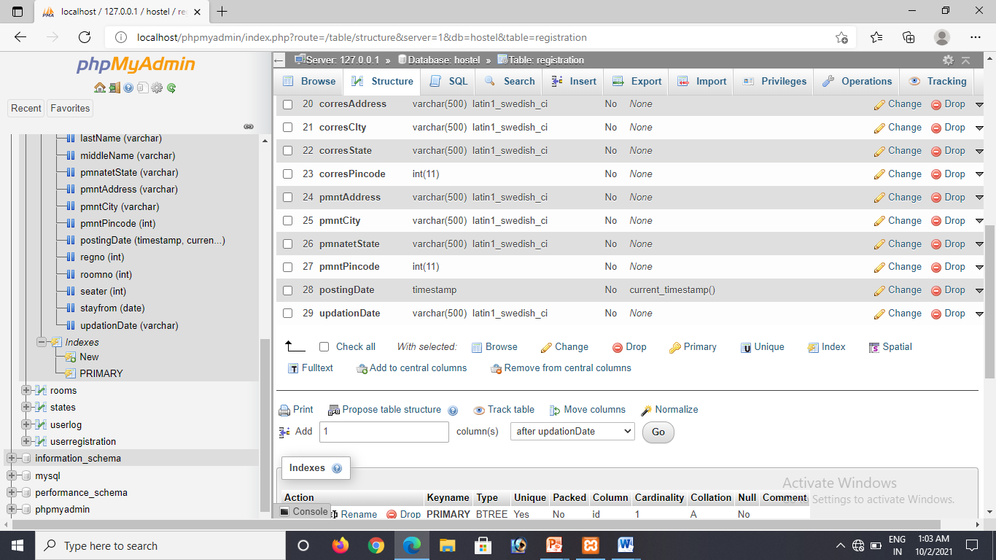

Slide 11
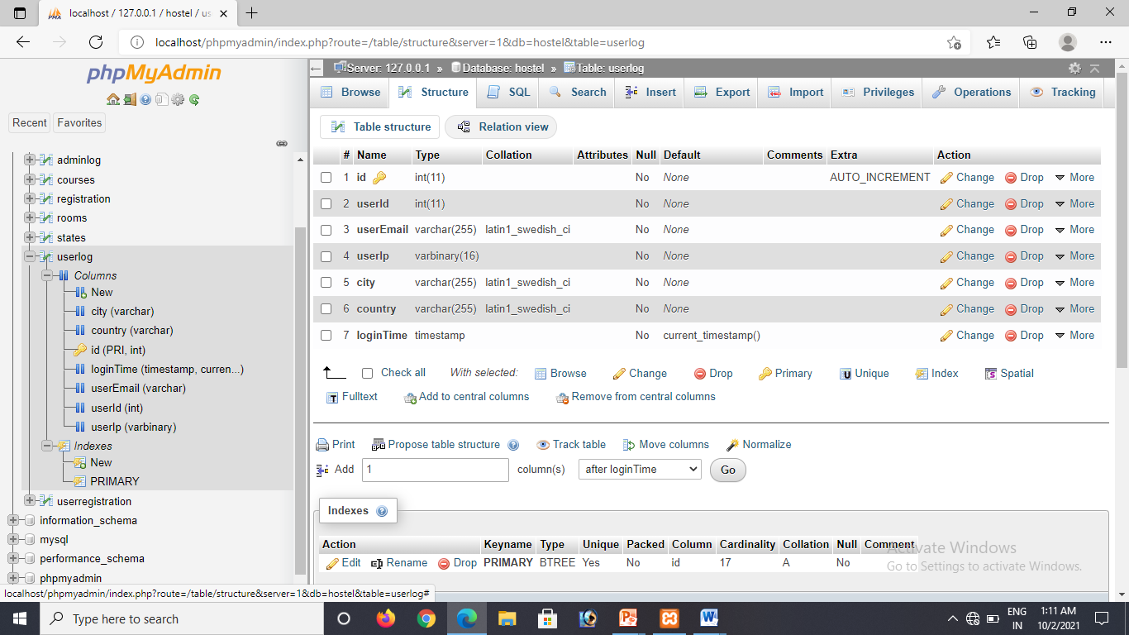
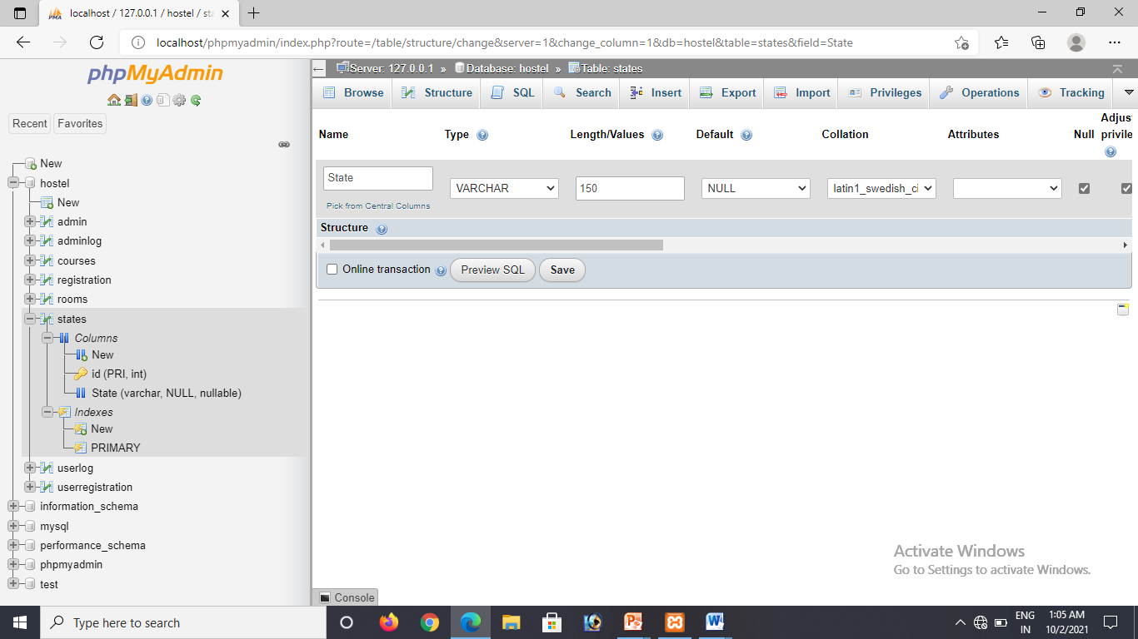
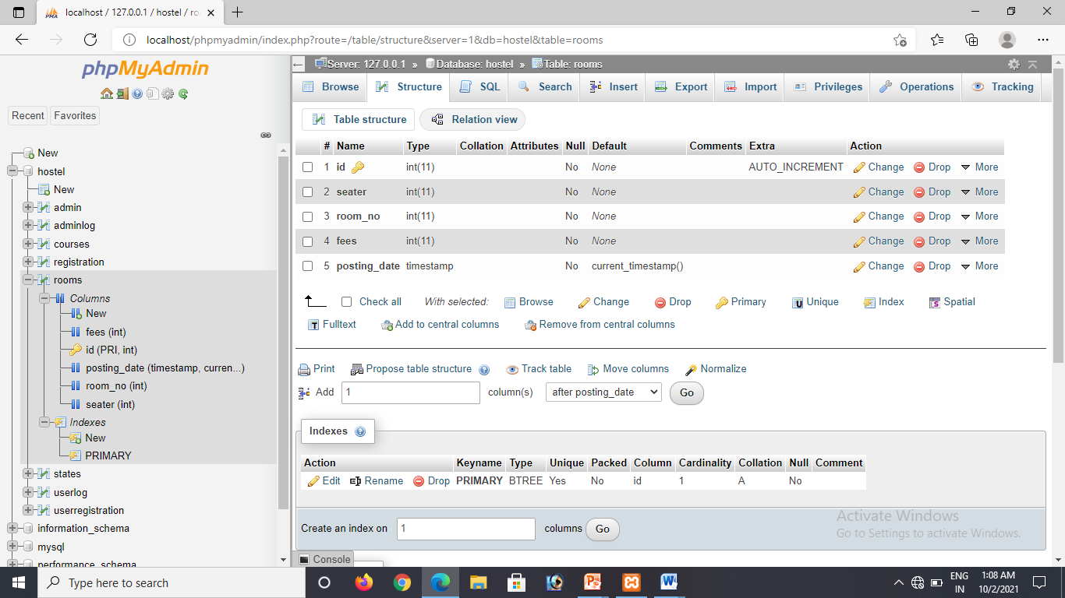

Slide 12
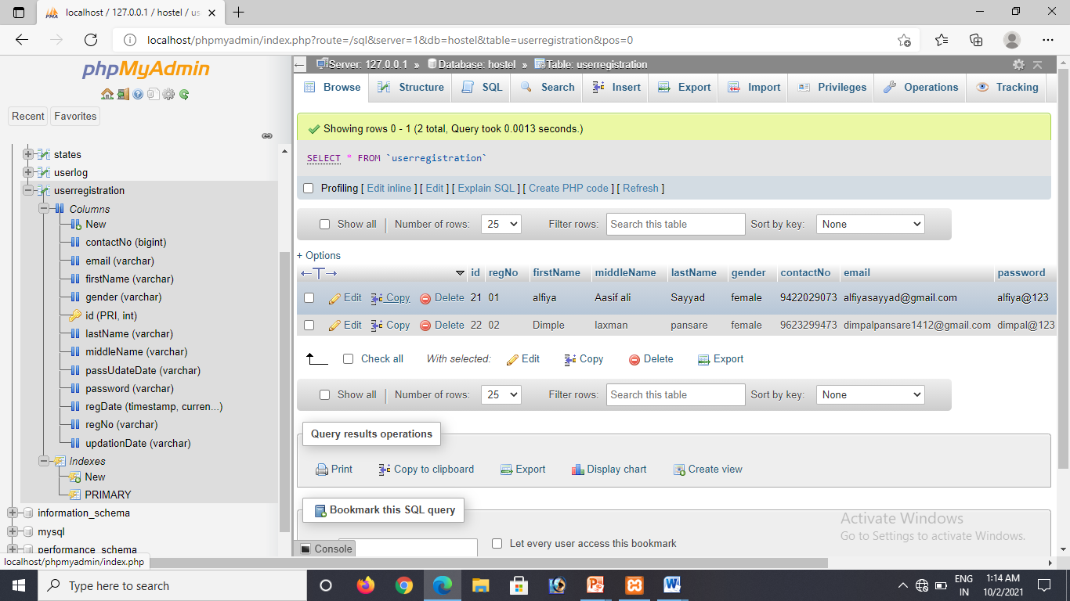

Slide 13
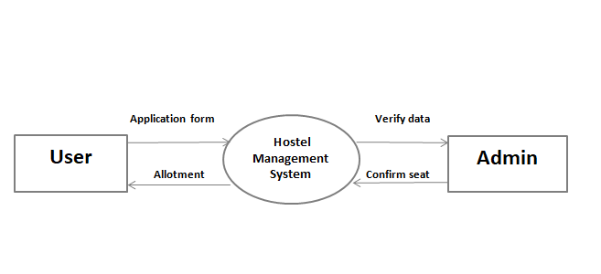
Modules

Slide 14
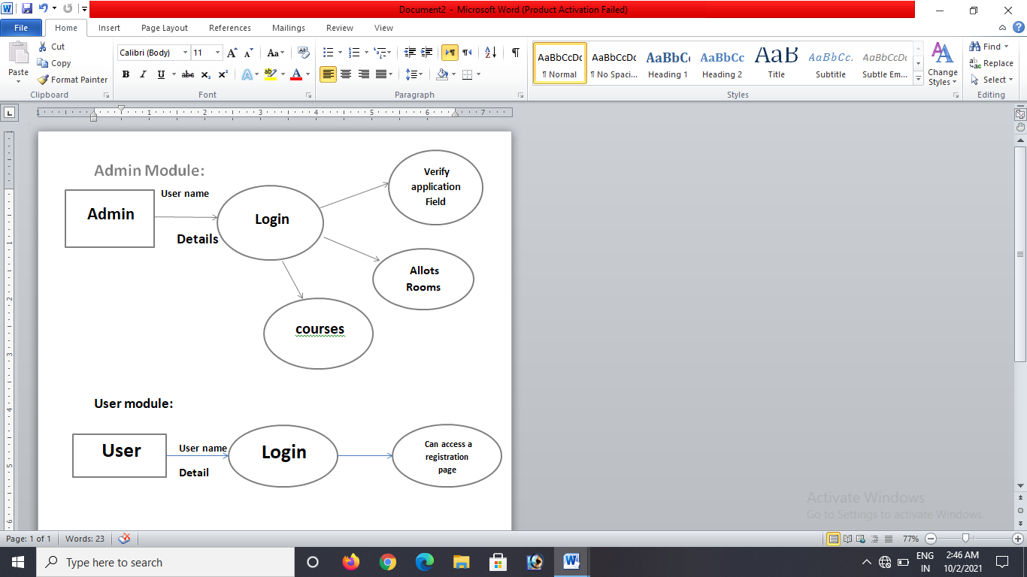

Slide 15
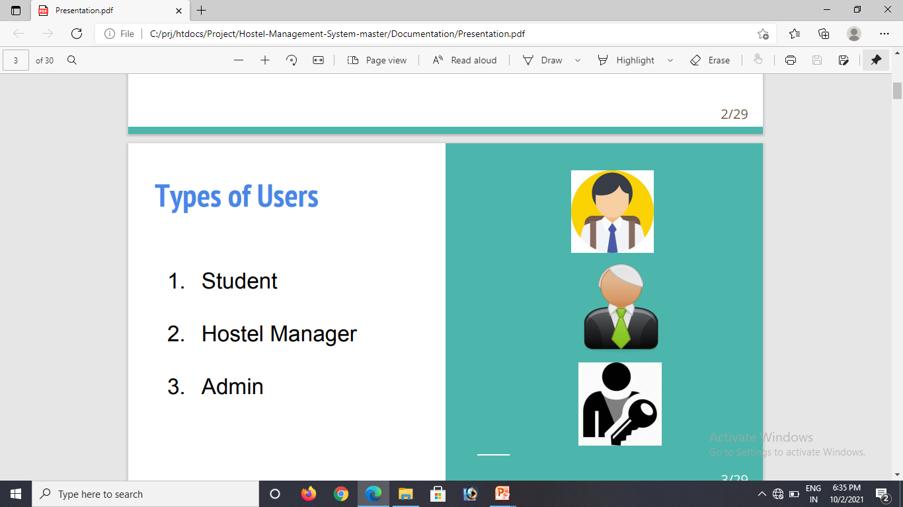
Types of Users
Student
Admin

Slide 16
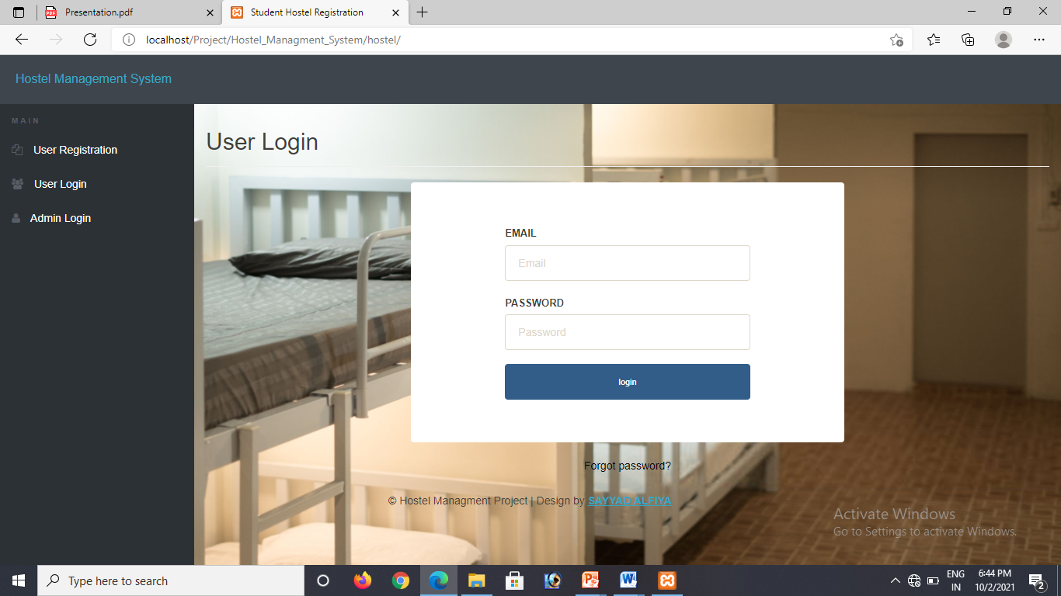
User login

Slide 17
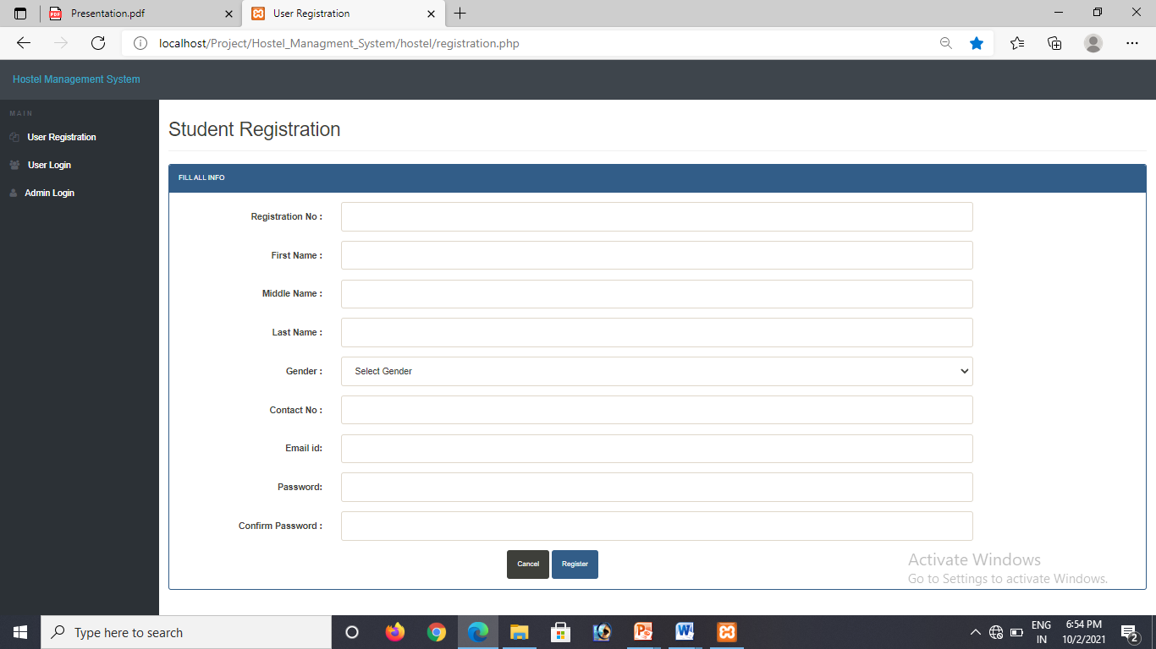
User Registration
Students who are not a part of the portal can register themselves here.
All the necessary error conditions are checked.(like if a user with the entered roll number already exists).

Slide 18
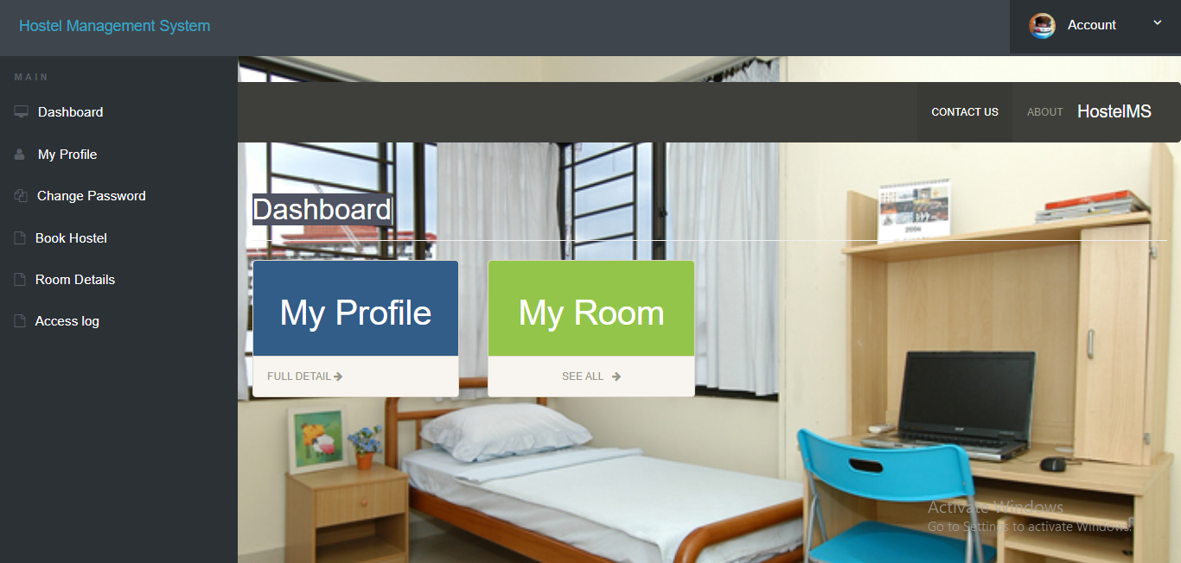
Dashboard

Slide 19
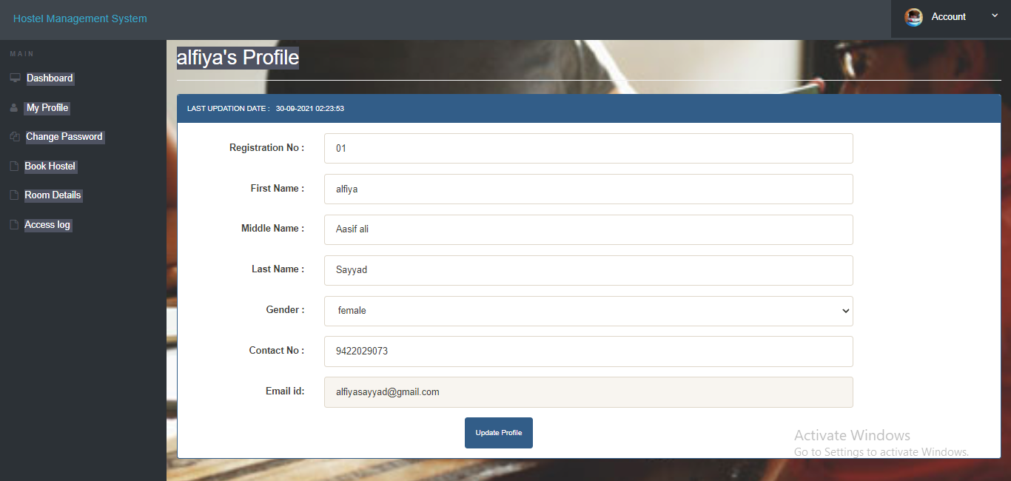
Profile Page

Slide 20
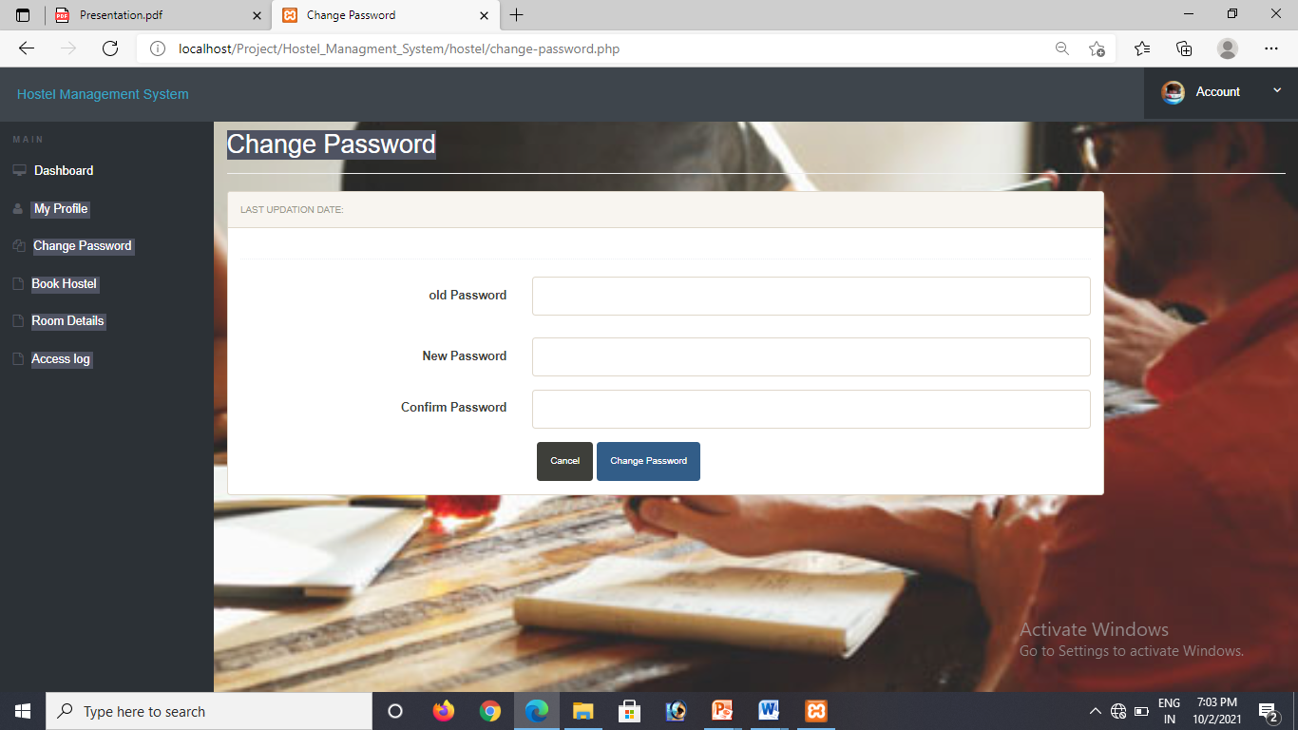
If you want to change password of your account you have able to change anytime

Slide 21
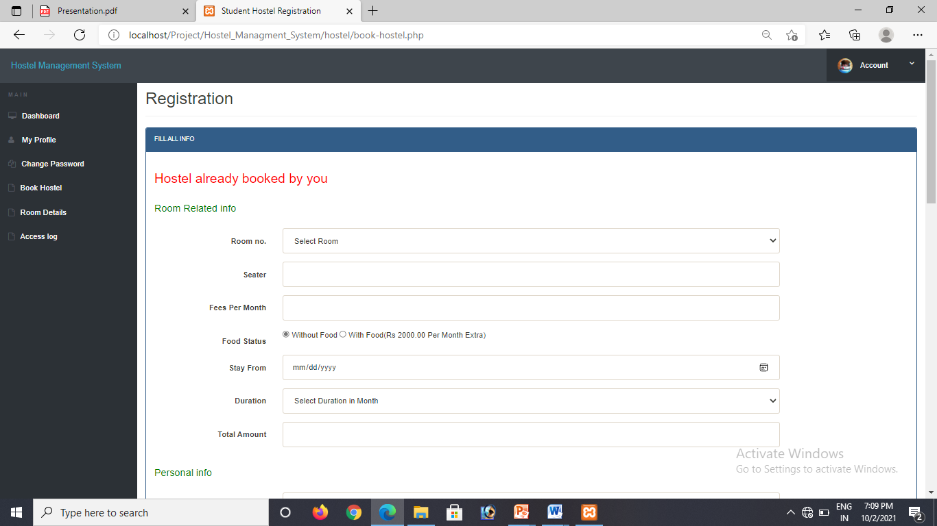
Hostel Booking

Slide 22
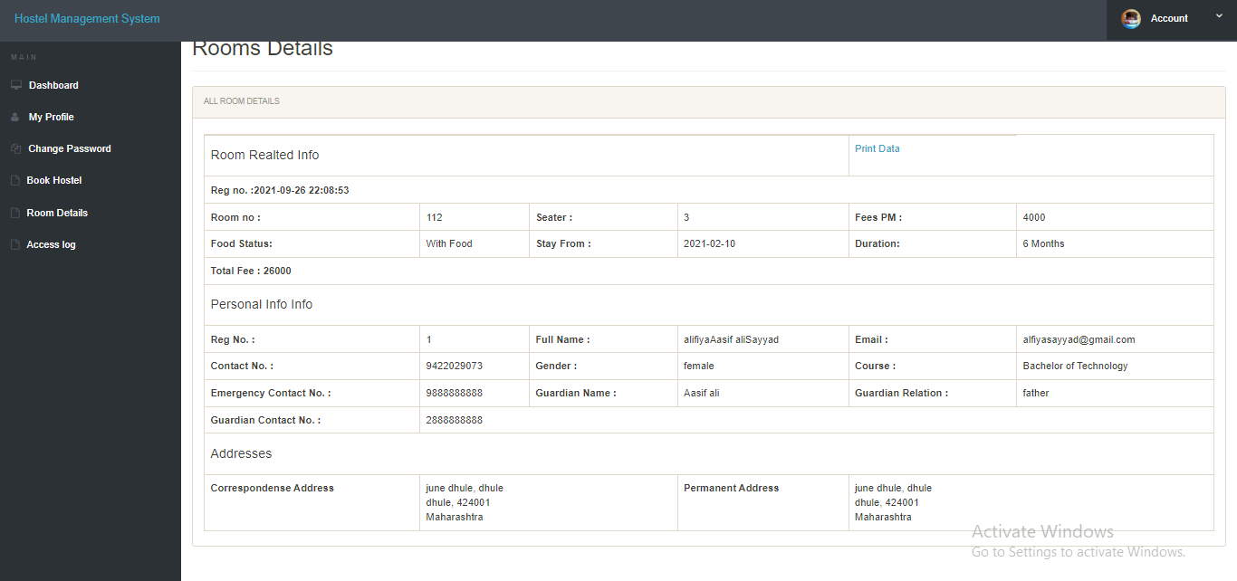
Room Details

Slide 23
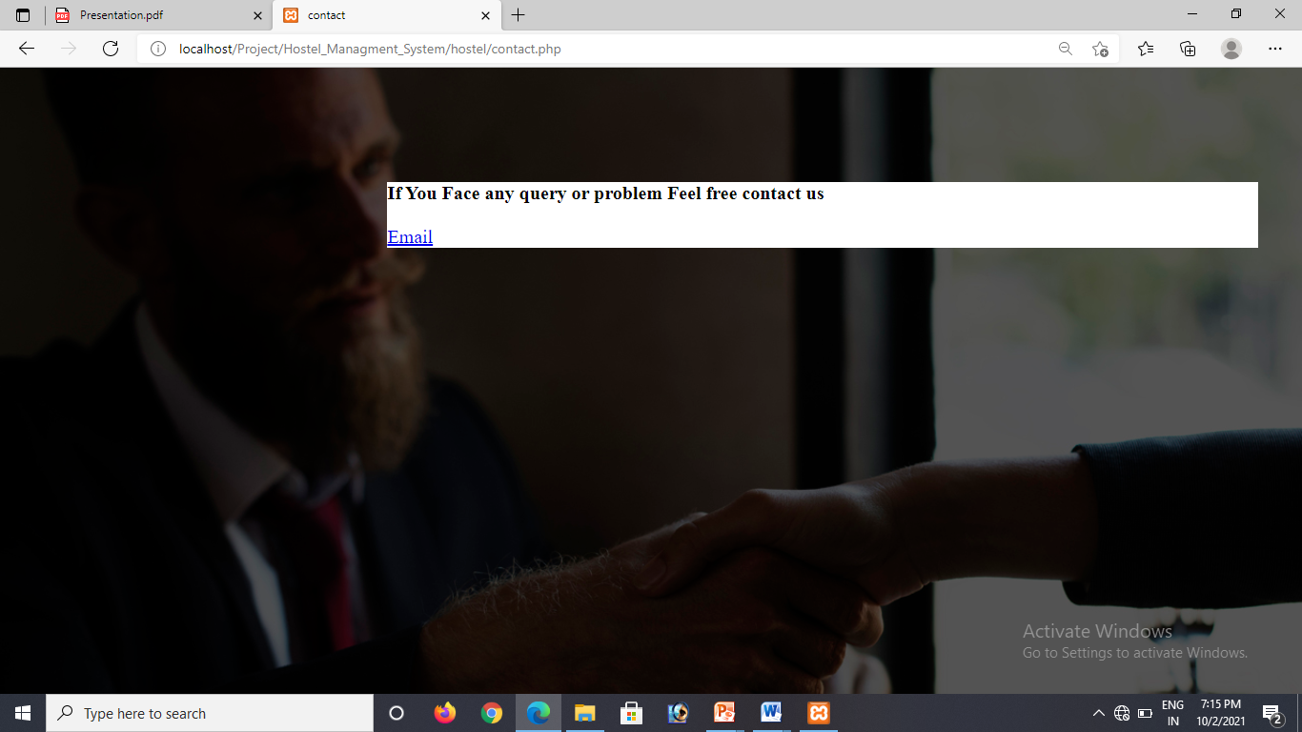
Student can send messages to hostel manager by filling up this form and clicking on the email button.

Slide 24
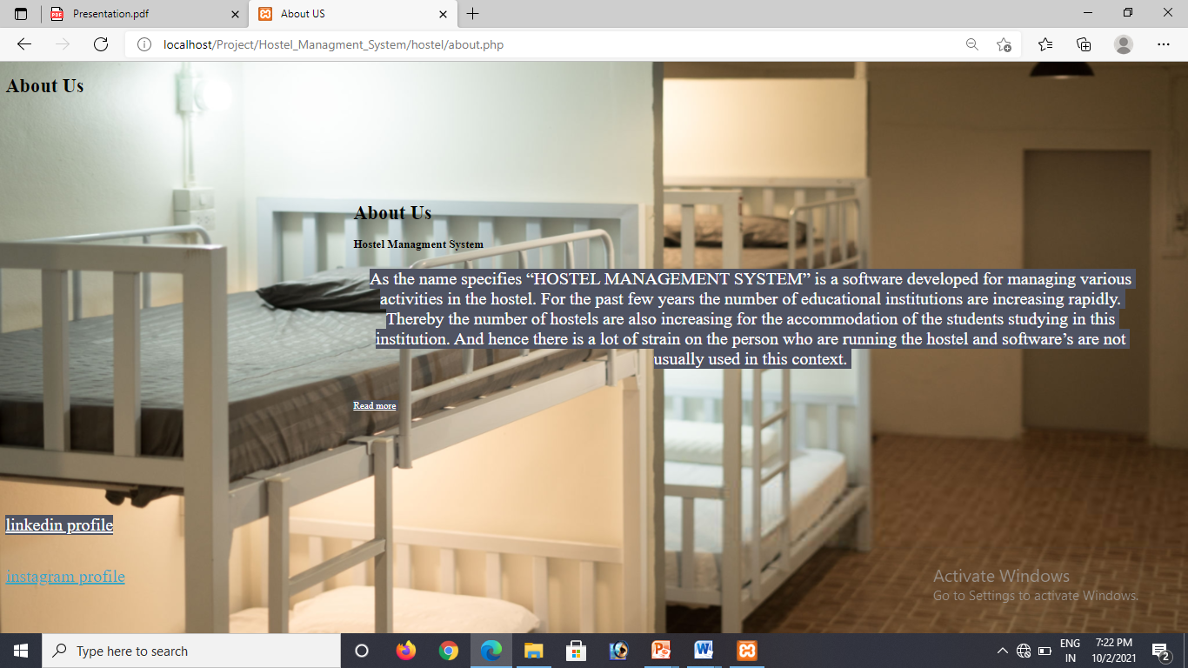
About Us Page

Slide 25
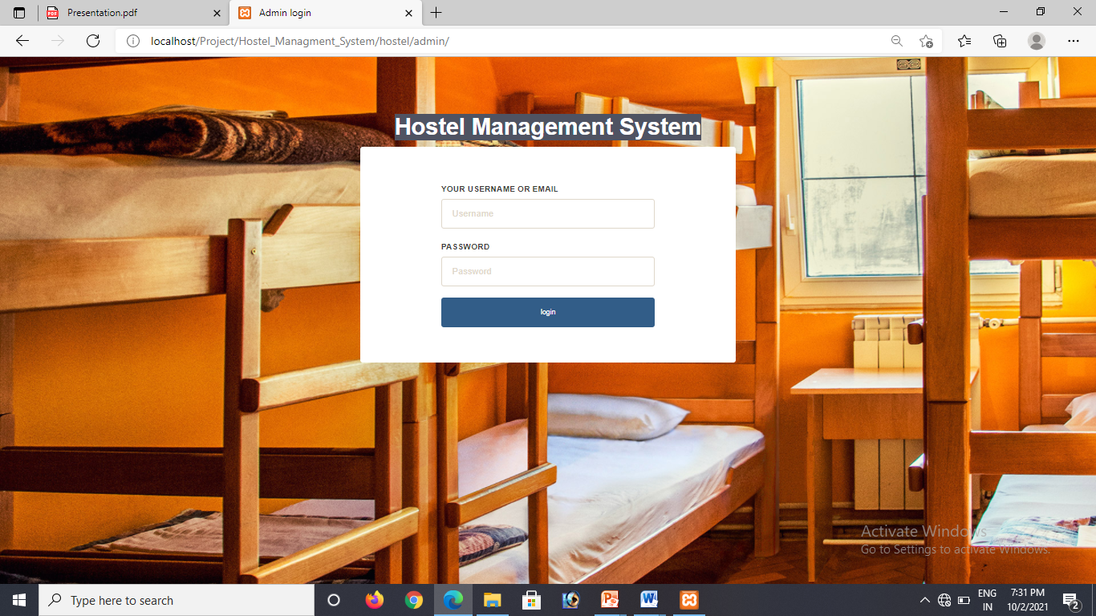
Admin page

Slide 26
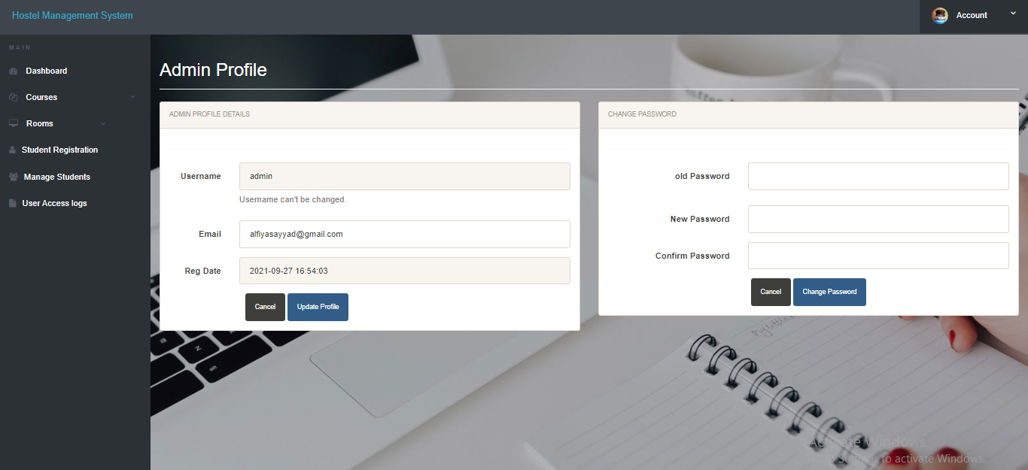
Admin Profile

Slide 27
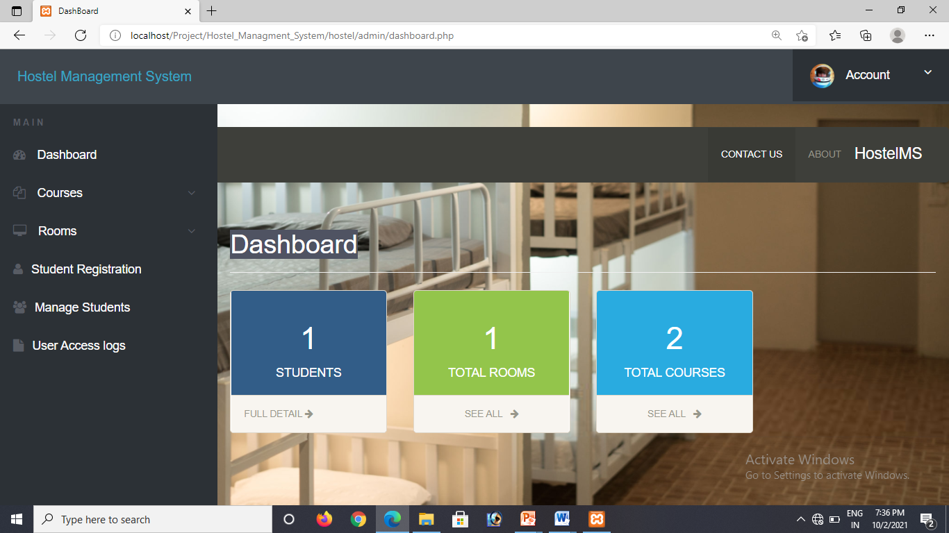
Dashboard

Slide 28
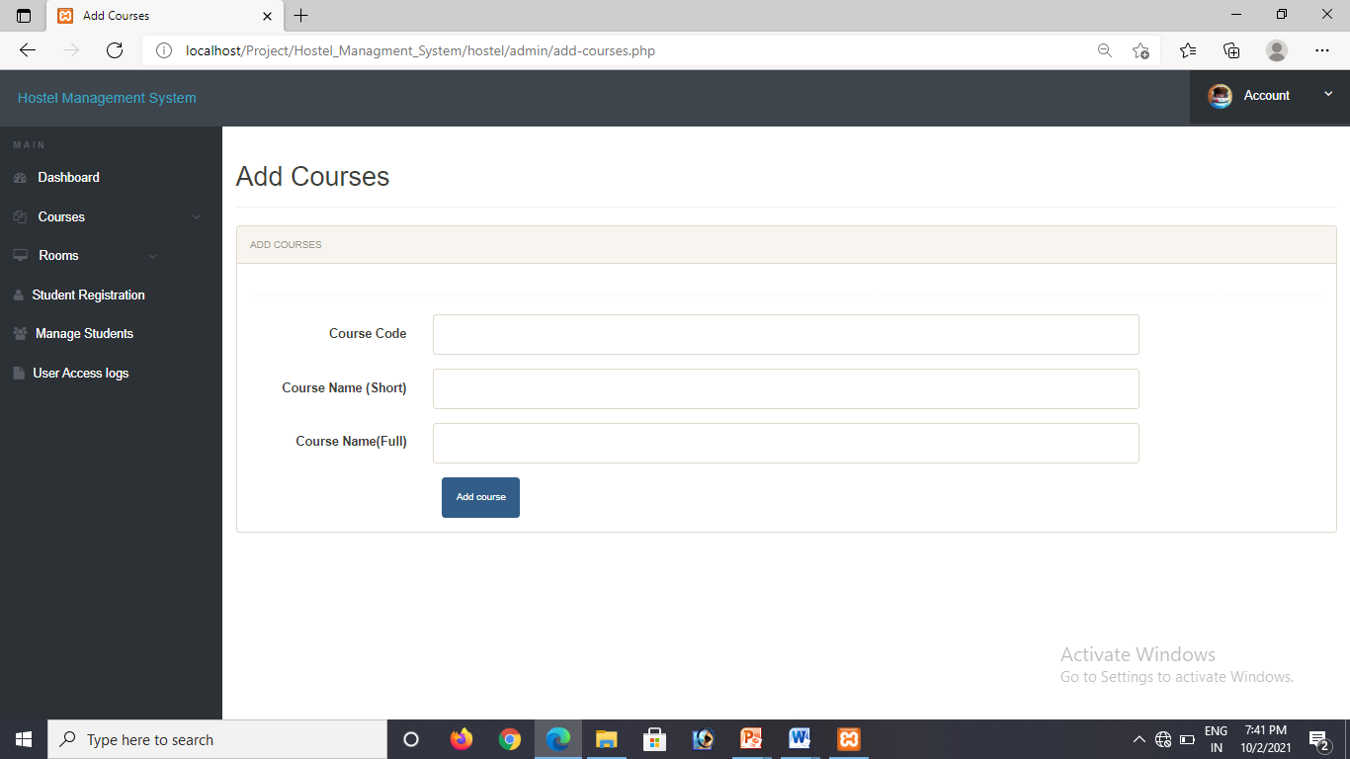
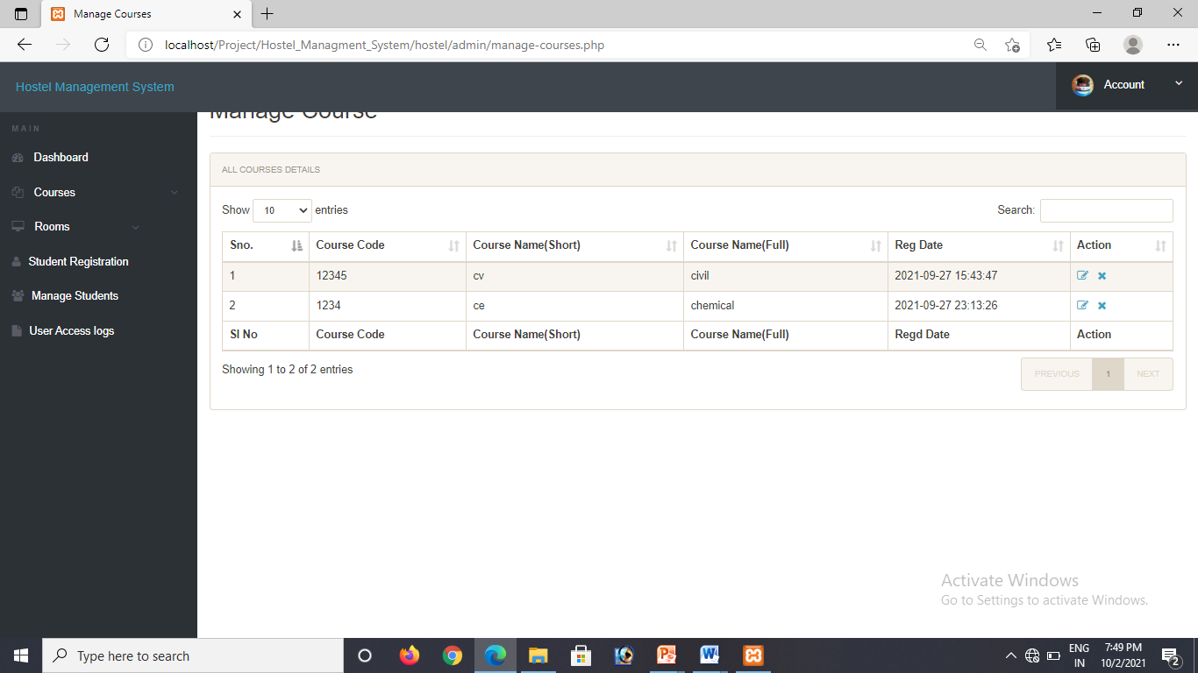
Courses

Slide 29

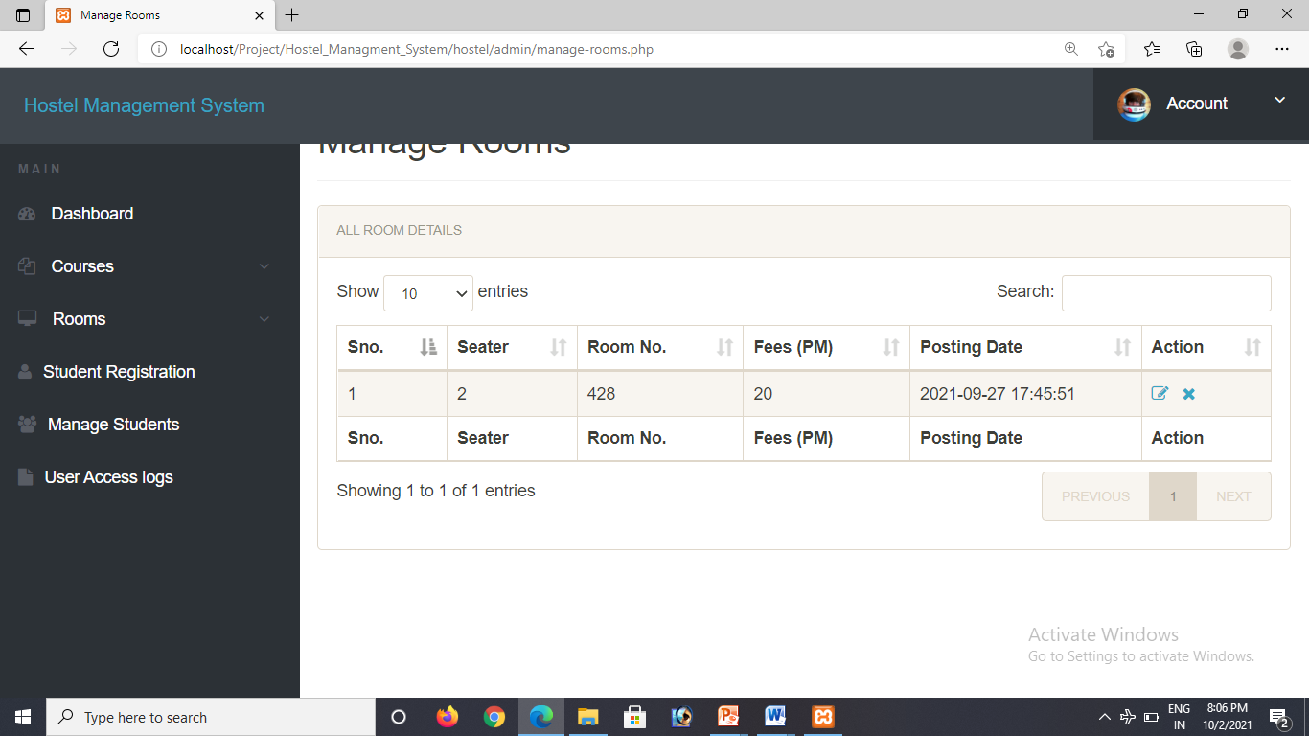
Rooms

Slide 30
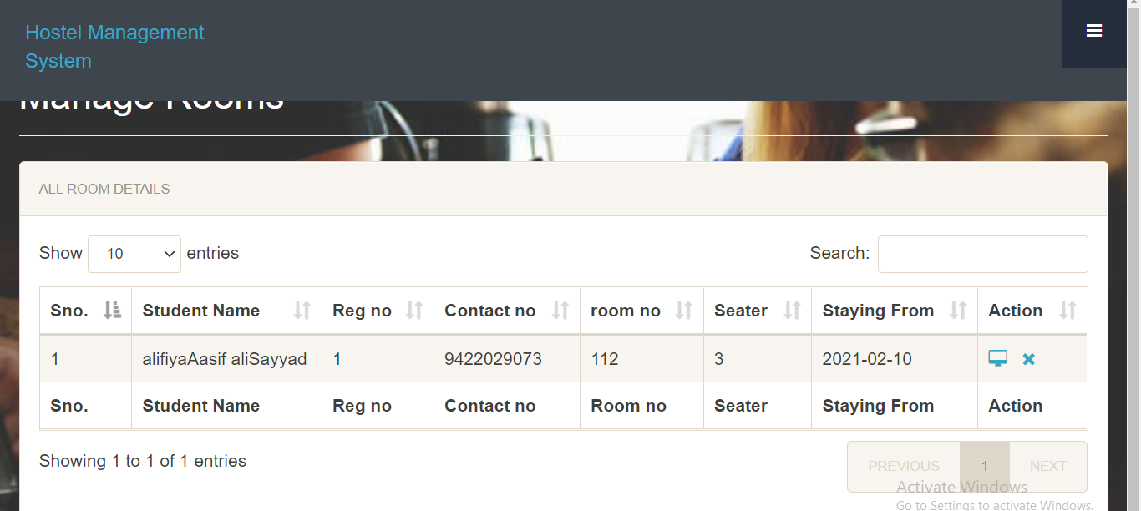
Manage student

Slide 31
Project Description
Hostel management system is a software which aims at the computerization of hostel management letting the entire process and its management be done using in computer.
This website has been designed in such a way that it helps both students as well as the admin.
It can be accessed completely by both student and admin regarding the rooms allotment , mess and much more.

Slide 32
THANKS!

